Slide 1
Cationic perylene dyes
Alafid F.¹, Hrdina R.¹, Burgert L.¹, Bouška M.¹, Pummerová M.², Pištěková H.², Sedlařík V. ², Trousil V..³, Kubáč L.³, Vyňuchal J.⁴, Procházková Bára ⁵, Lovecká P.⁵
1 – Univerzita Pardubice, Fakulta chemicko-technologická.
2 – Univerzita Tomáše Bati ve Zlíně, Centrum polymerních systémů, Univerzitní institut.
3 – Centrum organické chemie s.r.o., Rybitví.
4 – Synthesia a.s., Pardubice.
5 – Vysoká škola chemicko-technologická v Praze.
fouzyramadanali.alafid@upce.cz

Slide 2
Introduction
Perylenebisimides (PBIs) has a significant photochemical and electrochemical stability [1]. PBIs show intense fluorescence and high electron mobility[2]. It has uses for such type of applications because of their structural which can be modifying PBI's imide and bay positions by alkyl chains and functional groups [3,4]. The cationic PTCDI derivative were synthesized as the fluorescent probe. Because of the planar aromatic structure of the structure, it has a capability to aggregate through aromatic π–π stacking interactions. However, since it contains two positive charges, repulsive interactions between the electrostatic charges decrease its tendency to aggregate. As a result, in aqueous solution at ambient temperature, the cationic compounds exists in equilibrium between the aggregated form and the free monomeric form.
------------------------------------------------------------------------------------------------------------------
(1) Tsai HY, Chen KY. 1,7-Diaminoperylene bisimides: synthesis, optical and electrochemical properties. Dyes
Pigments 2013;96:319-27.
(2) Dinçalp H, Kizilok S, Içli S. Fluorescent macromolecular perylene diimides containing pyrene or indole units
in bay positions. Dyes Pigments 2010;86: 32-41.
(3) Yue W, Jiang W, B€ockmann M, Doltsinis NL, Wang Z. Regioselective functionalization of corepersubstituted
perylene diimides. Chem Eur J 2014;20: 5209-13.
(4) Wicklein A, Kohn P, Ghazaryan L, Thurn-Albrecht T, Thelakkat M. Synthesis and structure elucidation of
discotic liquid crystalline perylene imide benzimidazole. Chem Commun 2010;46:2328-30.

Slide 3
Experimental part
These compounds were synthesized according to a published procedure with minor modification (Wei Ji, et al,. The Royal Society of Chemistry 2018, Analyst, 2018, 143, 1899–1905).
Compound 1
Compound 2
Figure 1.

Slide 4
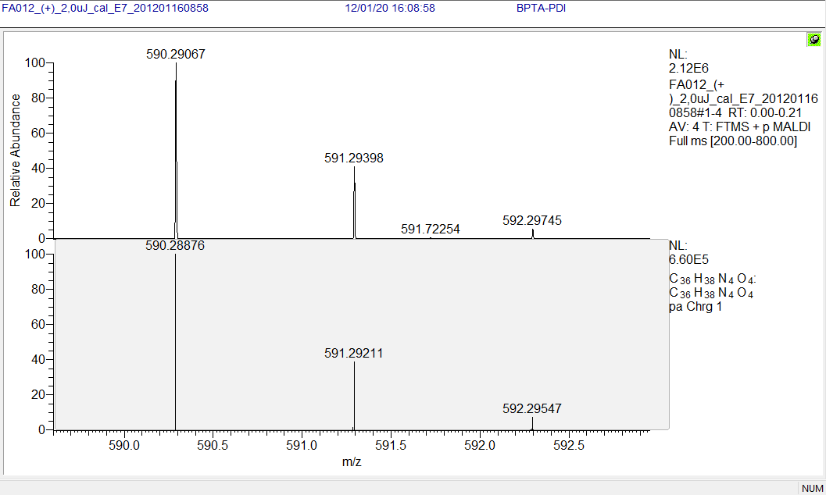
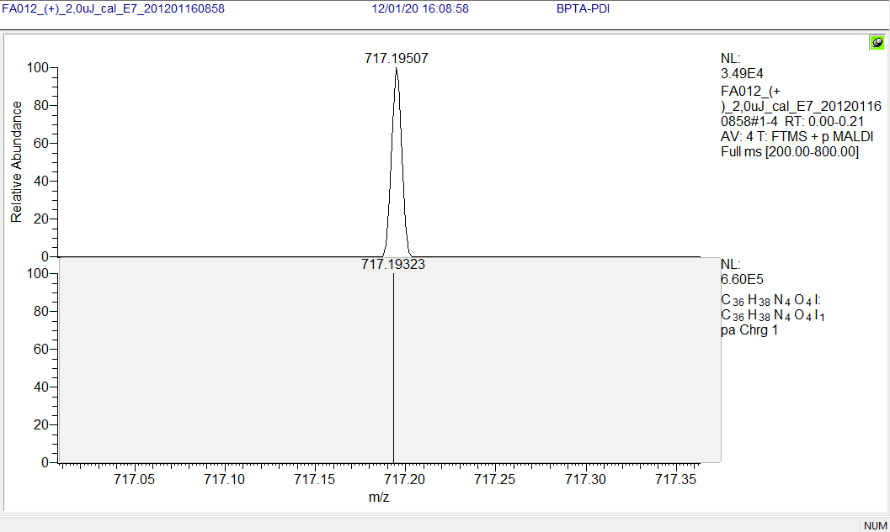
Characterization: Compound 1
Yield of Compound 1: 90 % related to PDA.
Elemental analysis : Calculated for C₃₆H₃₈N₄O₄I₂ : C, 50.13%, H, 4.54%, N, 6.63%, I, 30.05.
Found: C, 50.17%, H, 4.54%, N, 5.27%, I, 32.5.
HR-MALDI-MS (DHB): calcd for C₃₆H₃₈N₄O₄ m/z 590.28931 ([M-2I]²⁺), found 590.29067.
HR-MALDI-MS (DHB): calcd for C₃₆H₃₈N₄O₄I m/z 717.19377 ([M-I]⁺), found 717.19507.
The process resulted in primary crystals with an average value of 268.10-10 m (268 Å).
Figure 2: Compound 1.

Slide 5
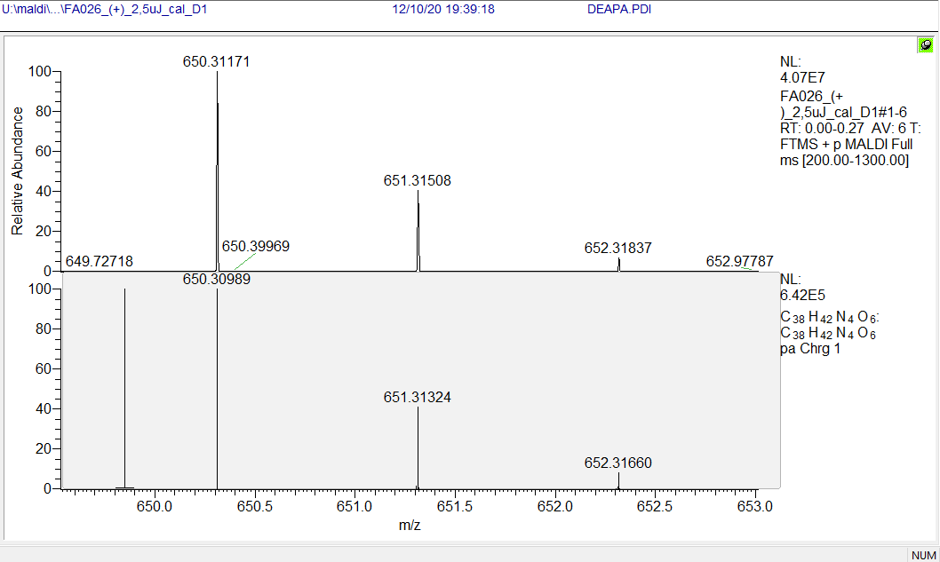
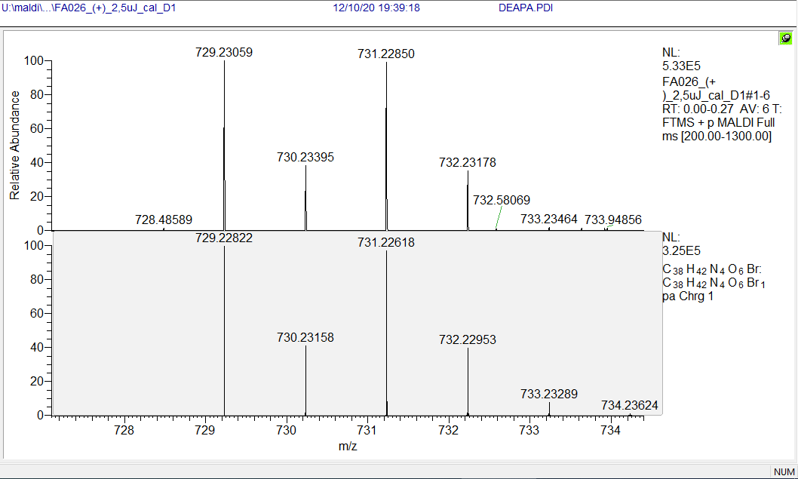
Characterization: Compound 2
Yield of Compound 2: 93 % related to PDA.
Elemental analysis : calculated for C₃₈H₄₂N₄O₆Br₂ :C, 56.31%; H, 5.22%; N, 6.91%; Br, 19.72%.
Found: C, 57.57%; H, 5.31%; N 7.02%; Br, 18.31%.
HR-MALDI-MS (DHB): calcd for C₃₈H₄₂N₄O₆ m/z 650.30989 ([M-2Br]⁺), found 650.31171.
HR-MALDI-MS (DHB): calcd for C₃₈H₄₂N₄O₆Br m/z 729.22822 ([M-Br]⁺), found 729.23059.
The process resulted in primary crystals with an average value of 155.10-10 m (155 Å).
Figure. 3: Compound 2.

Slide 6
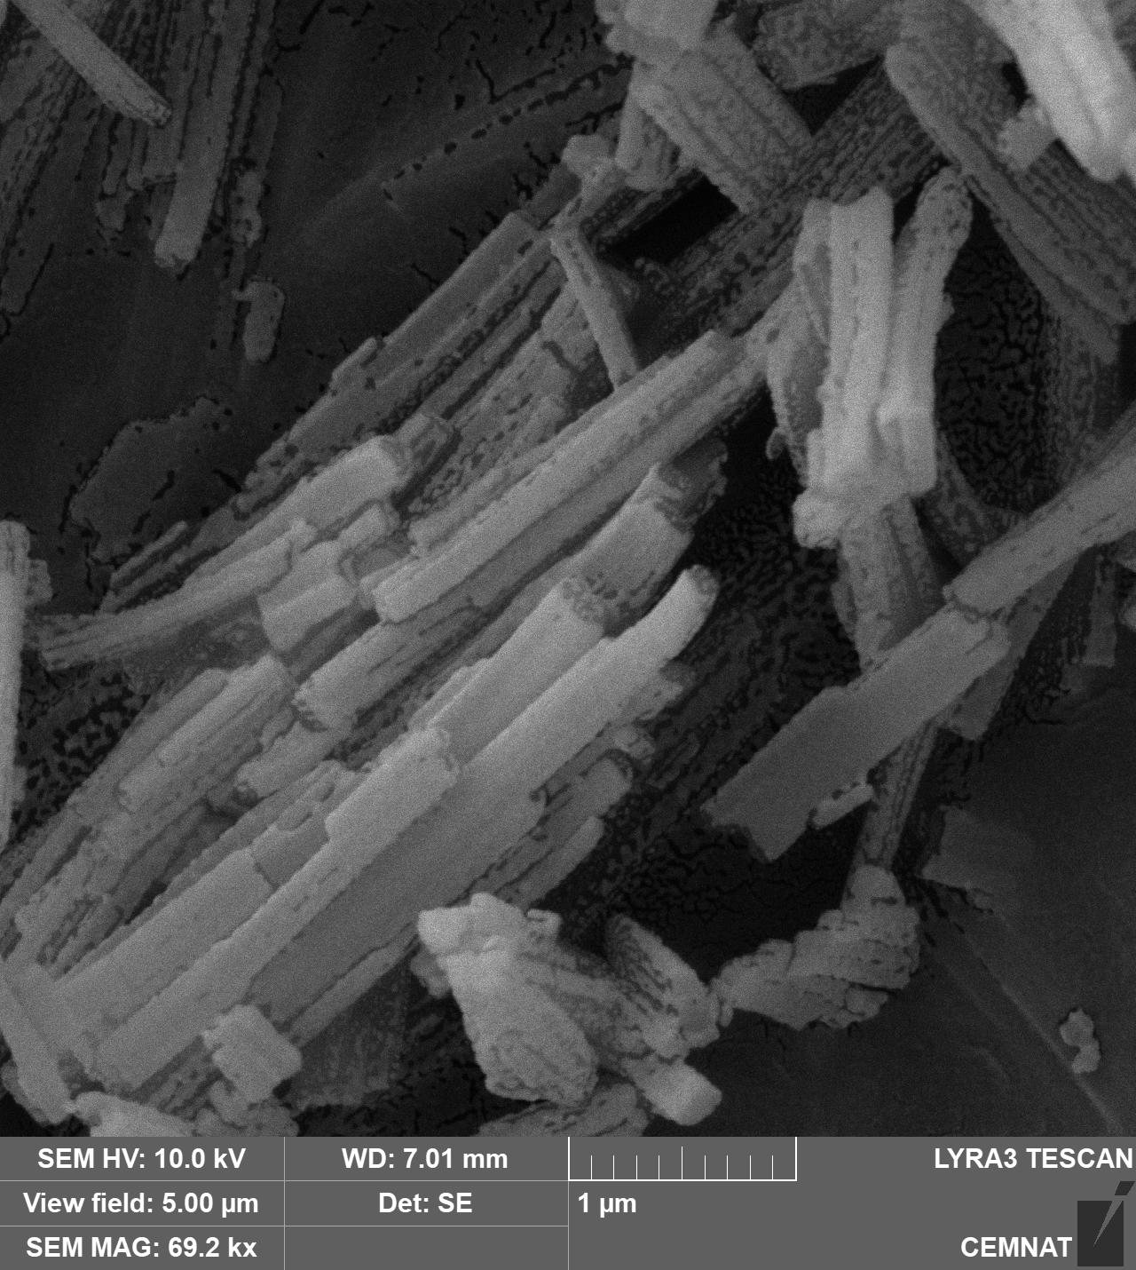
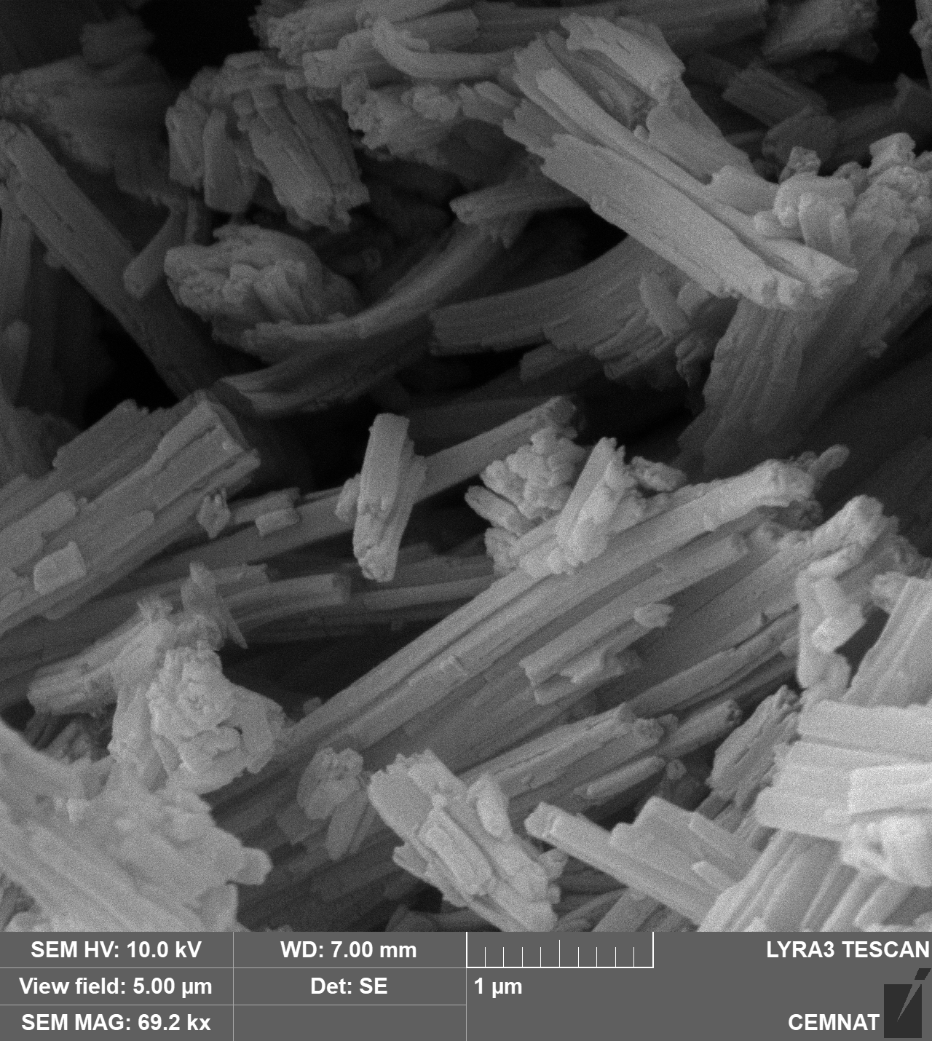
SEM
Compound 1
Compound 2
Figure.4

Slide 7
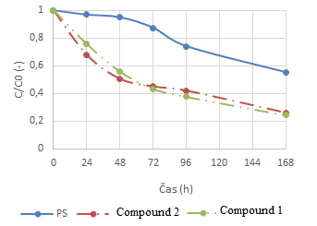
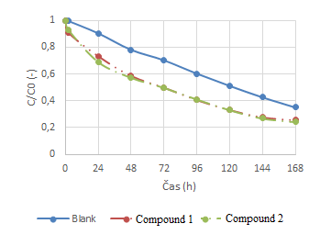
Singlet oxygen measurement of Compound 1 and 2
Table.1 Singlet oxygen production expressed as τ_{1/2} (s)
Product | τ_{1/2} (s) | Φ
Compound 1 | 11,3 | 0,24
Compound 2 | 12,4 | 0,22
Loss of DPP using the submitted samples
Loss of sodium salicylate using the submitted samples
Figure 5.
Both cationic perylenes have a high quantum yield and produce singlet oxygen in amounts slightly higher than chlorinated derivatives of perylene.

Slide 8
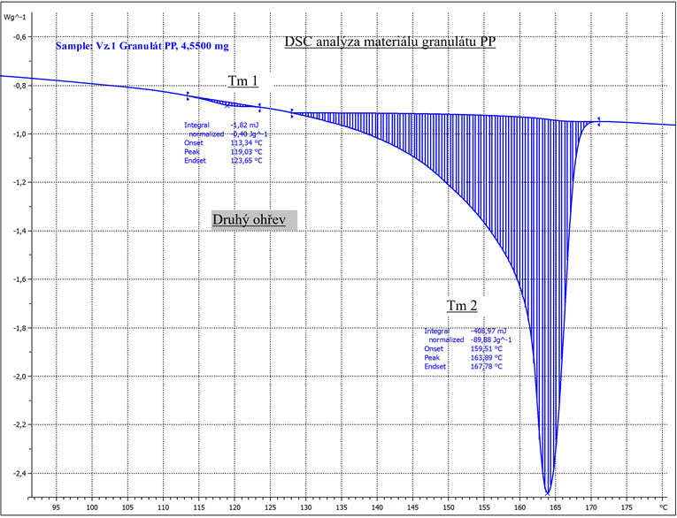
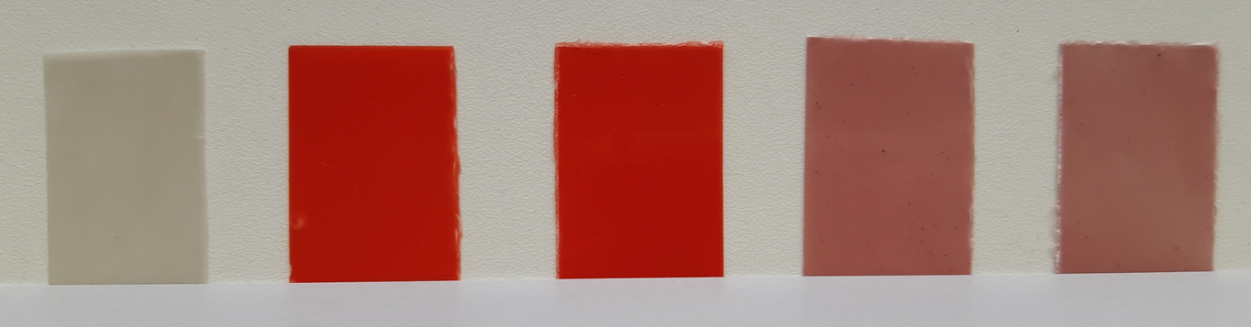
Differential scanning calorimetry (DSC) for PP granulate.
The dominant component of the PP polymer (T_{m} = 164 °C) it is also present in small amounts PE-HD (peak with T_{m} around 120°C).
Fig. 6 DSC analysis, material granulate PP, second heating
Figure.7 Samples after labeling: Polypropylene (left), Compound 1(middle ), Compound 2 (right).

Slide 9
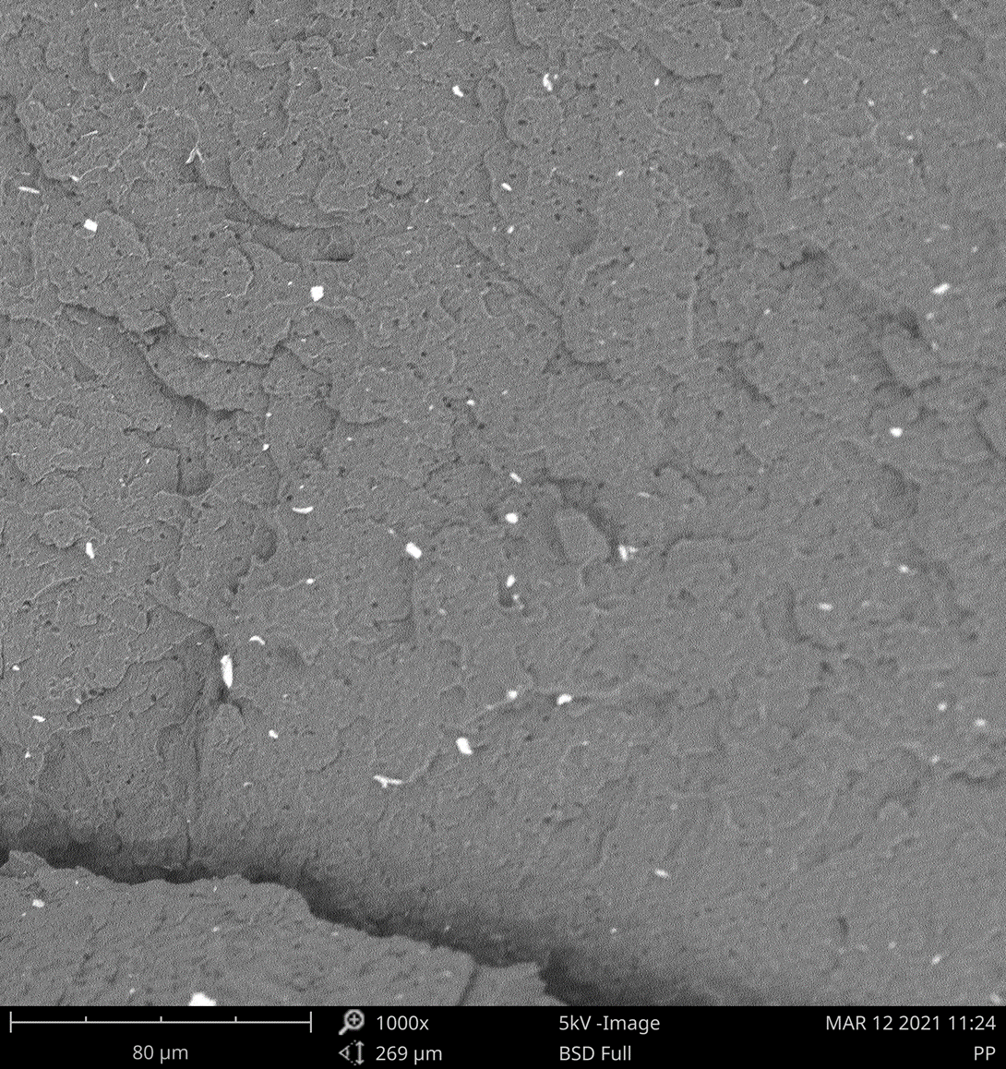
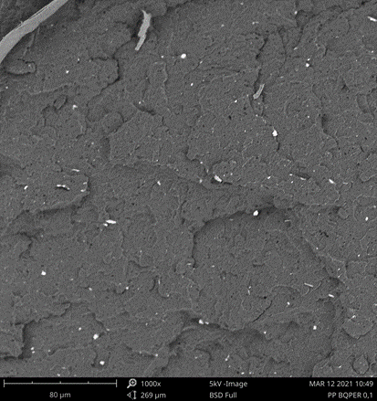
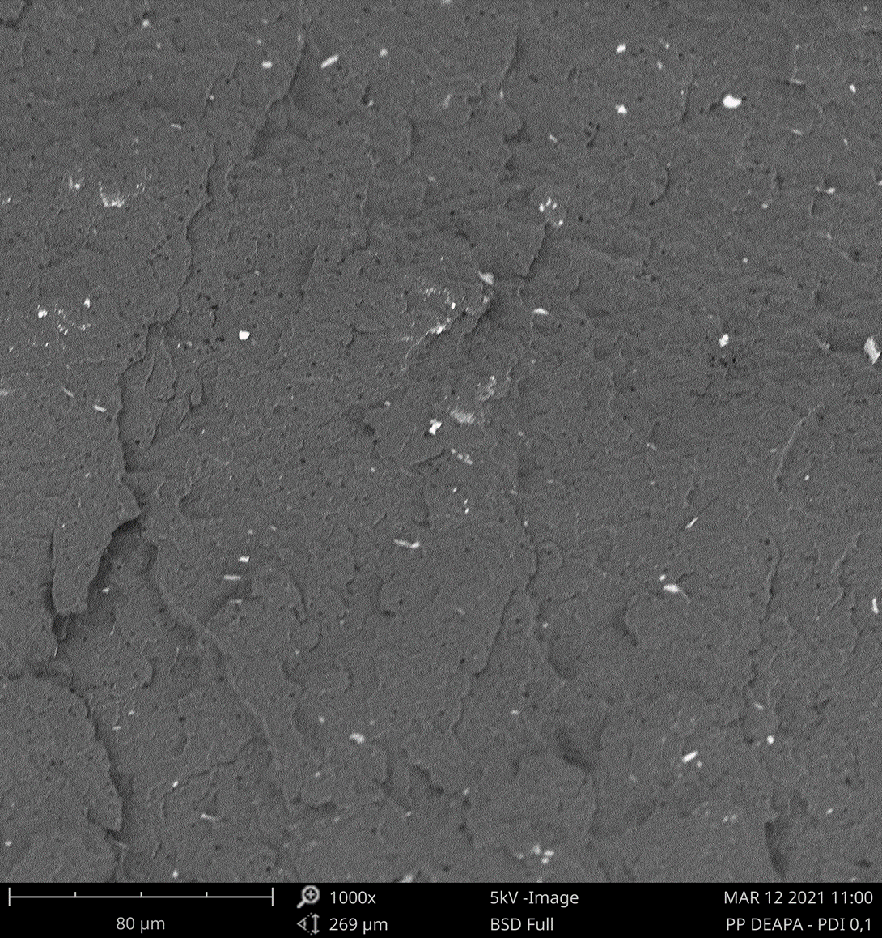
SEM.
Images of the fracture side of the samples show a homogeneous distribution of additives in the polypropylene matrix. The PP matrix itself appears to be additive with a tile-shaped particulate filler.
Fig. 8 SEM PP images Polypropylene (left), Compound 1(middle ), Compound 2 (right).

Slide 10
Table 2. Results of antibacterial activity of PP samples against bacterial strain Staphylococcus aureus, E.coli and Candida albicans
Antibacterial activity
 |  | Staphylococcus aureus |  |  | Escherichia coli |  |  | Candida albicans
 |  | N (CFU/cm²) | log N | R | N (CFU/cm²) | log N | R | N (CFU/cm²) | log N | R
PP (reference) | Shaken immediately | 8,2.10³ | 3,9 | - | 4,4.10⁴ | 4,7 | - | 1,0.10³ | 3,0 | -
 | with exposure | 4,5.10⁴ | 4,7 |  | 6,0.10⁵ | 5,8 |  | 5,3.10⁴ | 4,7
 | in the dark | 9,3.10⁴ | 4,9 |  | 7,3.10⁵ | 5,9 |  | 6,4.10⁴ | 4,8
PP + Compound 1 | with exposure | 1,6.10⁴ | 4,2 | 0,5 | 3,0.10⁵ | 5,5 | 0,3 | 9,2.10³ | 4,0 | 0,7
 | in the dark | 9,4.10⁴ | 4,9 | 0 | 3,1.10⁵ | 5,5 | 0,4 | 7,2.10³ | 3,9 | 0,9
PP + Compound 2 | with exposure | 4,1.10³ | 3,6 | 1,1 | 2,7.10⁵ | 5,4 | 0,4 | 9,5.10¹ | 2,0 | 2,7
 | in the dark | 1,4.10⁴ | 4,2 | 0,7 | 3,7.10⁵ | 5,7 | 0,2 | 1,5.10³ | 3,2 | 1,6

Slide 11
Antibacterial activity
Table 3. Results of the concentration of viable bacteria and the values of antibacterial activity (A) against growth Staphylococcus aureus
Sample |  | S. aureus CCM 4516
 |  | c (CFU/ml) | log c
1 - 100% cotton MILETA, reference | Shaken immediately | 1,2.10⁴ | 4,1
 | Incubated with exposure | 1,5.10³ | 3,2
 | Incubated in the dark | 1,5.10⁵ | 5,2
2 – 100% cotton + compound 1, st. coloring 3 %, wt. XENOTEST 1, 3 %, Compound 1 | Shaken immediately | 8,9.10² | 2,9
 | Incubated with exposure | < 1 | 0
 | Incubated in the dark | 3,0.10⁰ | 0,5
3 - 100% cotton + compound 1, st. Coloring 5 %, wt. XENOTEST 2, 5 %, Compound 1 | Shaken immediately | 2,2.10³ | 3,3
 | Incubated with exposure | < 1 | 0
 | Incubated in the dark | 1,0.10⁰ | 0
4 - 100% cotton + compound 2, st. coloring 3 %, wt. XENOTEST 3, 3 Compound 2 | Shaken immediately | 2,2.10³ | 3,3
 | Incubated with exposure | < 1 | 0
 | Incubated in the dark | 2,5.10⁰ | 0,3
5 - 100% cotton + compound 2, st. Coloring 5 %, wt. XENOTEST 4, 5 %, Compound 2 | Shaken immediately | 2,7.10⁴ | 4,4
 | Incubated with exposure | < 1 | 0
 | Incubated in the dark | < 1 | 0

Slide 12
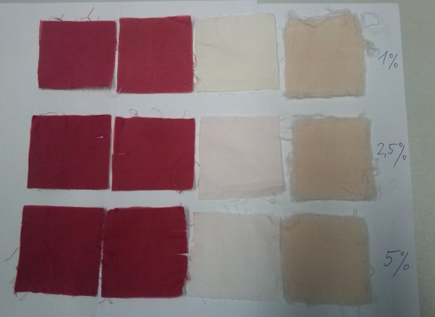
Application
Figure.9 Compound 1, Color fastness to washing at 60 °C according to ČSN EN ISO 105 - C06 (800 120). Dyed material: 100% cotton.

Slide 13
Table 4. Color shade and color change
Color shade 1% - color change | Staining cotton | Staining wool
4 – 5 R | 3 – 4 | 3
Color shade 2.5% - color change | Staining cotton | Staining wool
4 – 5 R | 3 | 3
Color shade 5% - color change | Staining cotton | Staining wool
4 – 5 R | 3 – 4 | 3

Slide 14
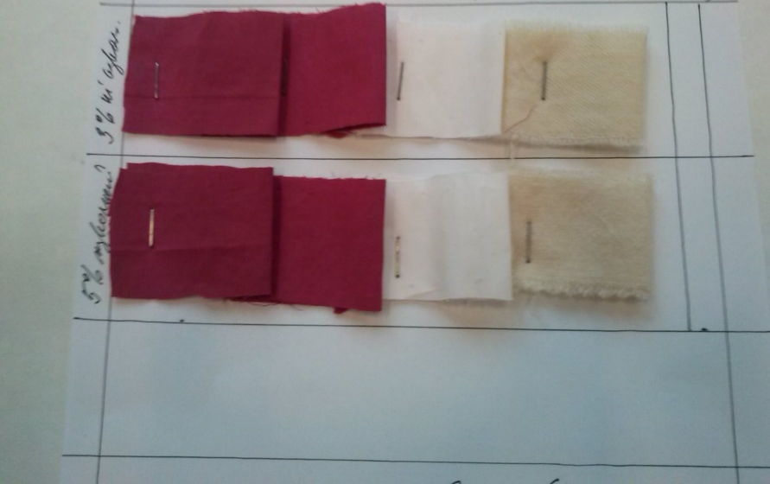
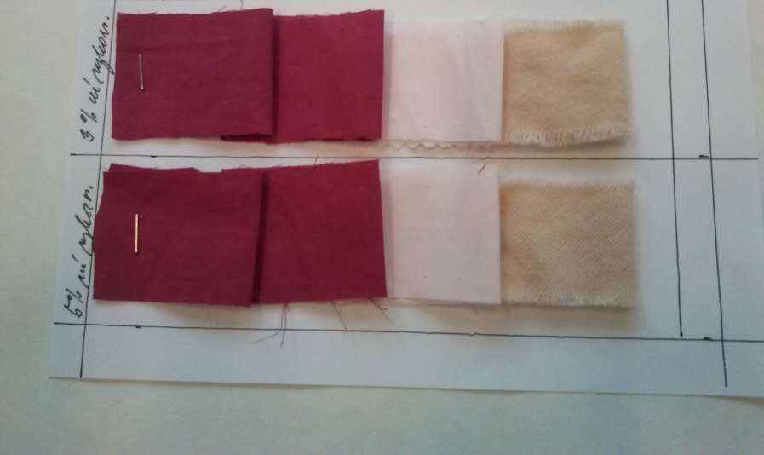
Figure.10 Wash fastness at 40°C( left) and 60° C (right) - ČSN EN ISO 105 – C06 (800 120). Dyed material :100% cotton.

Slide 15
Table 5. Wash fastness 40°C, and at 60°C
Wash fastness 40°C | Staining cotton | Staining wool
Color shade 3 % - color change 4 – 5 R | 4 | 4
Color shade 5 % - color change 4 – 5 R | 4 | 3 - 4
Wash fastness 60°C | Staining cotton | Staining wool
Color shade 3 % - color change 4 – 5 R | 3 | 2 - 3
Color shade 5 % - color change 4 – 5 R | 3 | 2

Slide 16
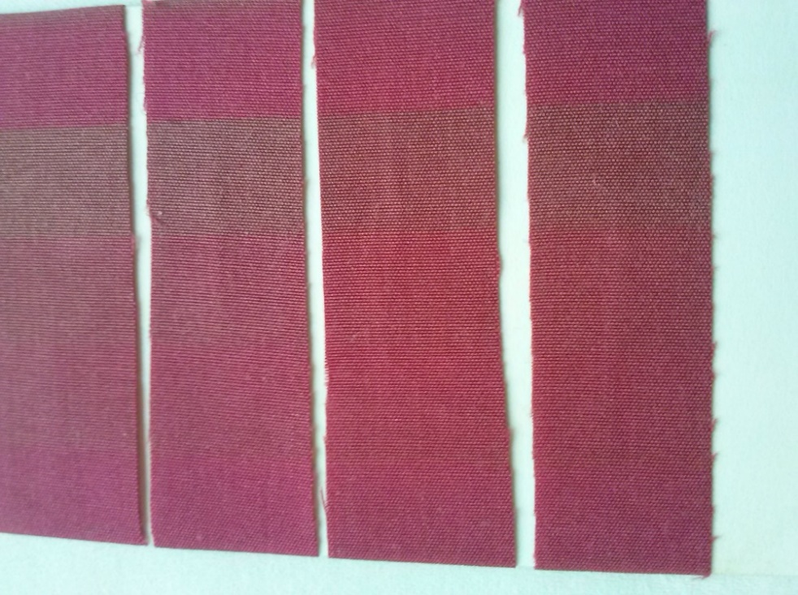
LIGHTFASTNESS – XENOTEST (ISO 105-B02).
Table. 6 Lightfastness
Sample | Lightfastness XENOTEST
Compound 1 Color shade 3% | 3
Compound 1 Color shade 5% | 3
Compound 2 Color shade 3% | 3
Compound 2 Color shade 5% | 3
Figure.11 Dyed material: 100% cotton. Evaluated immediately after the xenostest.

Slide 17
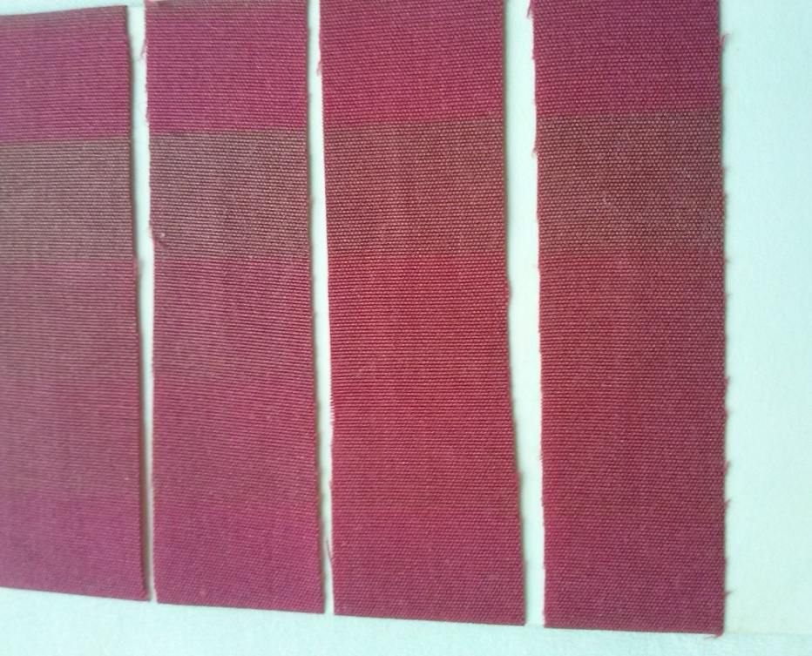
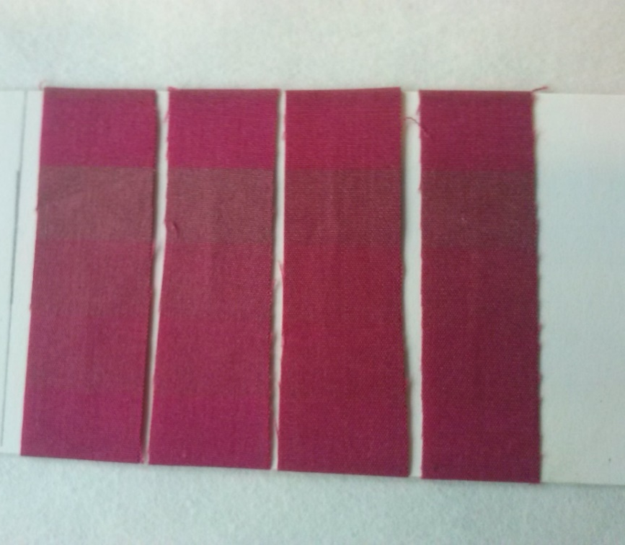
If the samples are stored in the dark after the xenotest, the coloration will return to this level in a few days which mean it is photochromic dye:
Figure.12: Immediately after the xenostest (on the left), after 14 days in dark (on the right).

Slide 18
Acknowledgements
This work was supported by the grant TRIO program, Ministry of Industry and Trade, Czech Republic, project MPO TRIO FV30048.

Slide 19

Thank You For Your Attention

